Slide 1
There are 6 hidden words. Where are they?

Slide 3
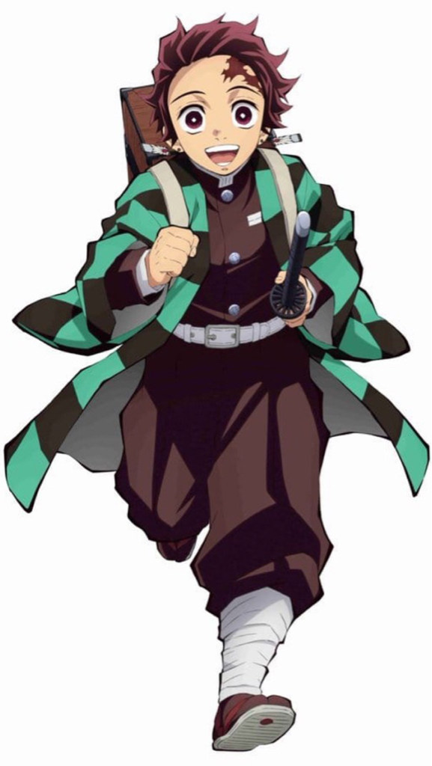
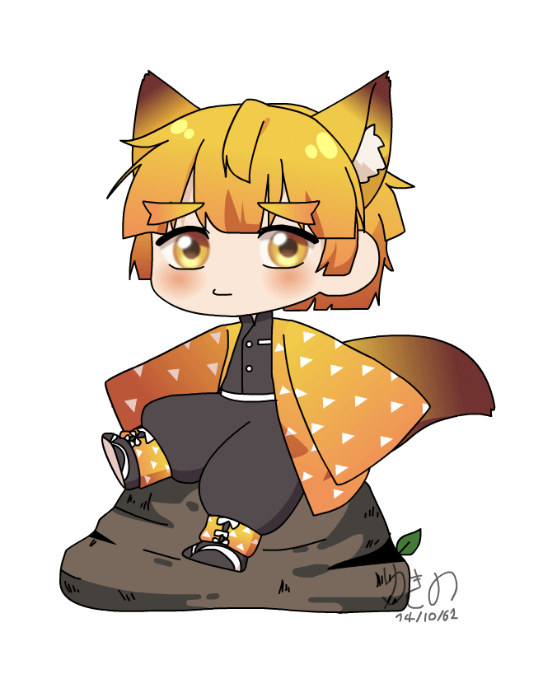
Did you finish your homework last week?
Maybe…yes!
酷課雲
Unit 3線上測驗
Unit4聽力作業
Due date is 6/4!!

Slide 4
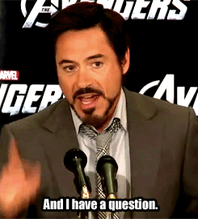
作業有問題如何詢問Tr. Mandy?
1. 寄email : mandy77727@syes.tp.edu.tw
2. Google meet 直播課最後離開教室前

Slide 5
Unit 4- Vocabulary I

Slide 6
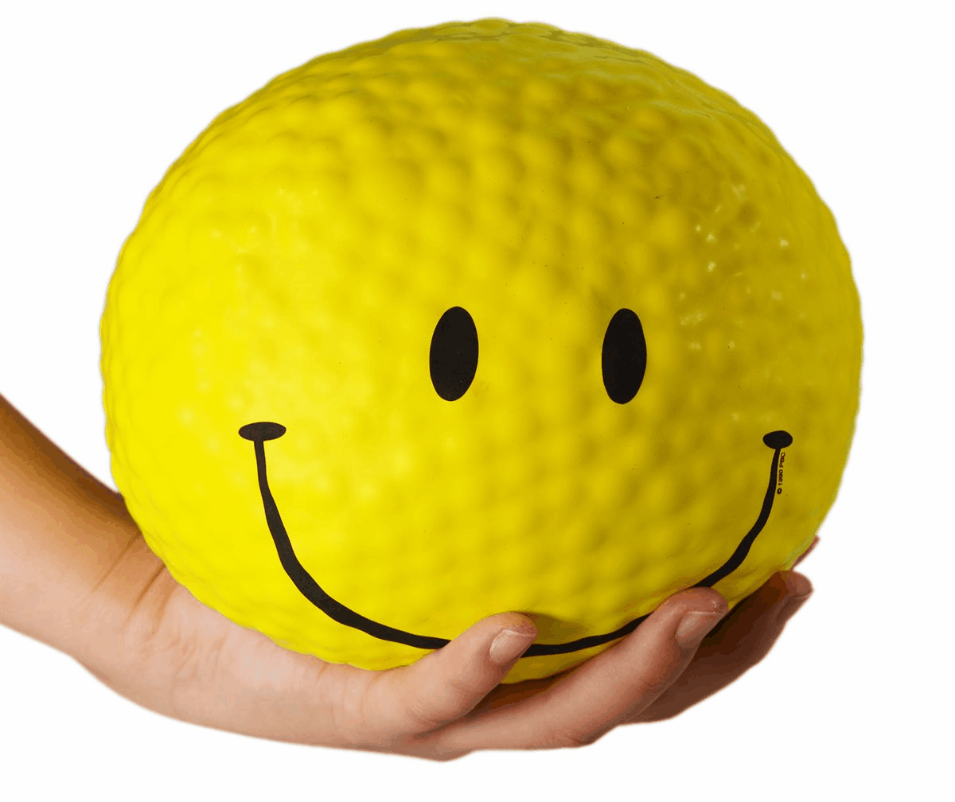
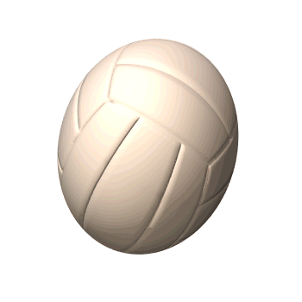
ball
a baseball
a pokéball
a basketball
a soccer ball
a volleyball

Slide 7
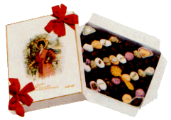
box
a candy box
a mail box
a gift box

Slide 8
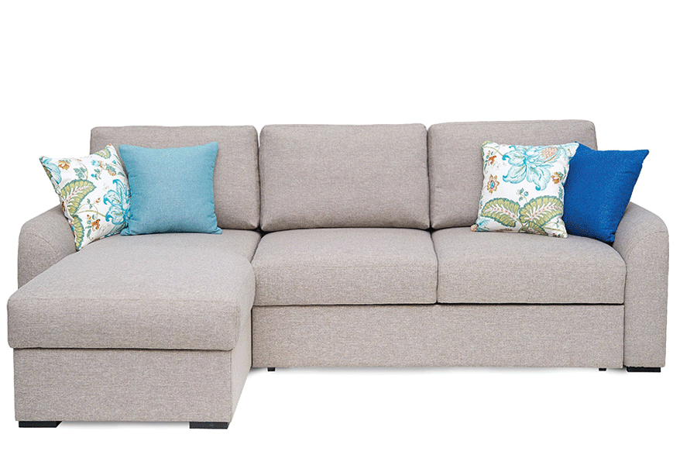
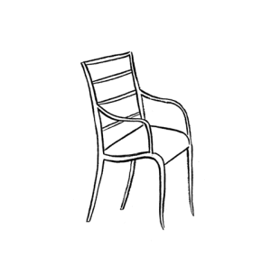
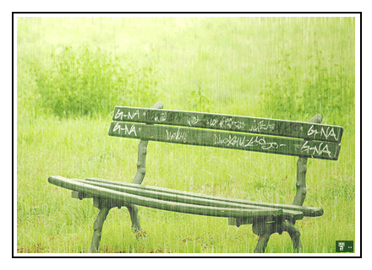
chair
a sofa
a bench

Slide 9
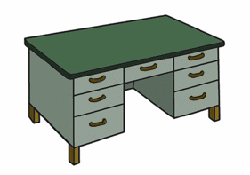
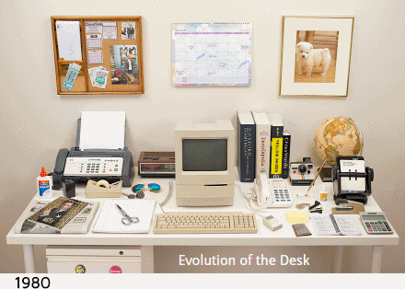
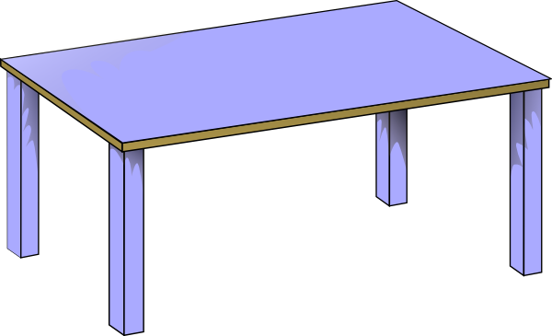
desk
a desk
a table

Slide 10
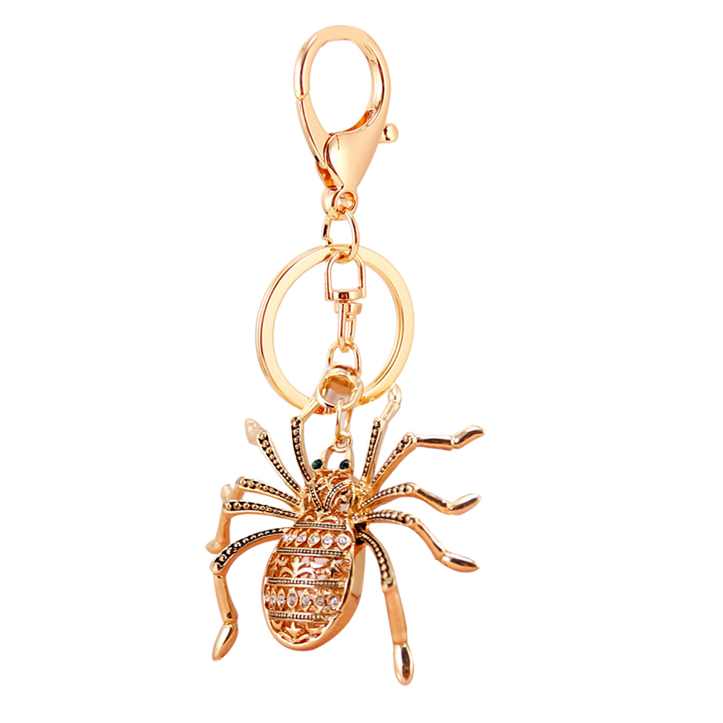
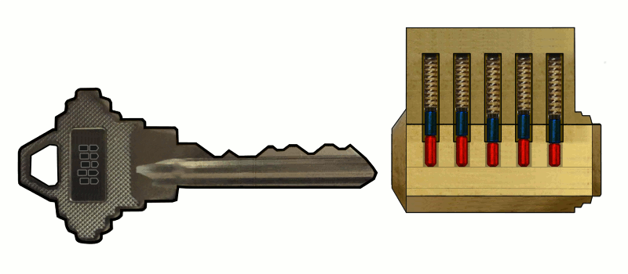
key
We can use the key to lock.
a key ring

Slide 11
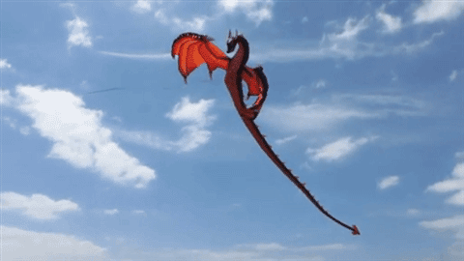
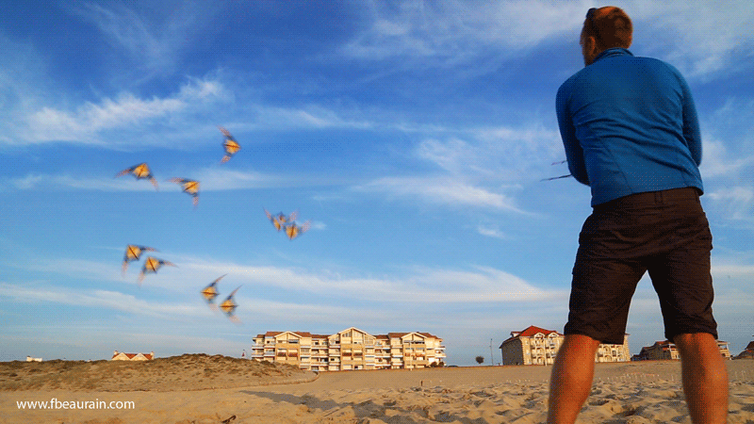
kite
fly a kite

Slide 12
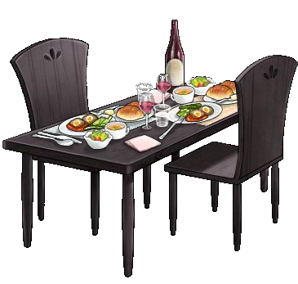
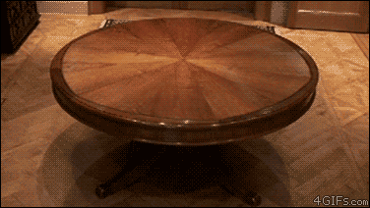
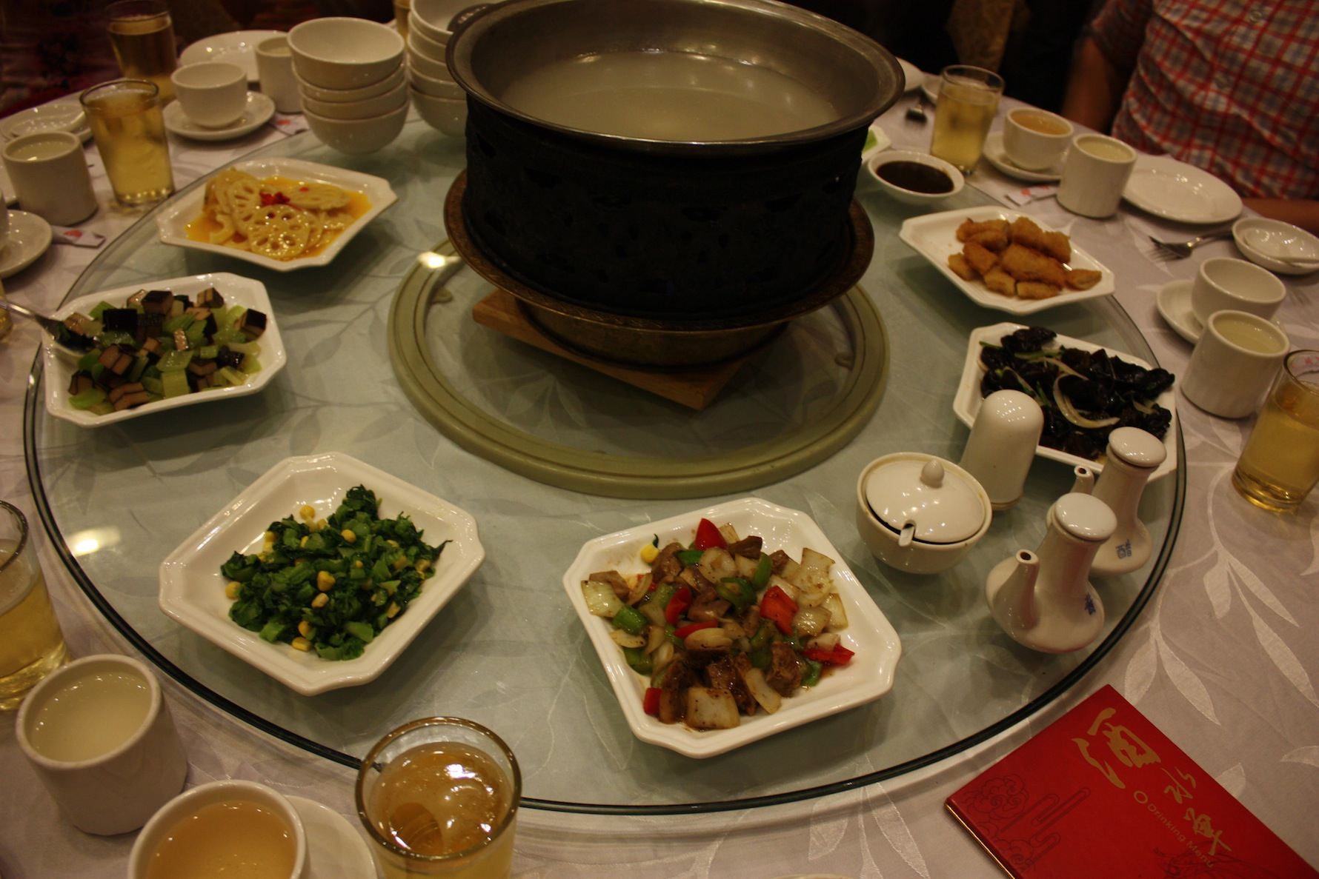
table
dining table
lazy Susan

Slide 13
a box
a ball
chairs
a key
a table
a kite
a desk

Slide 14
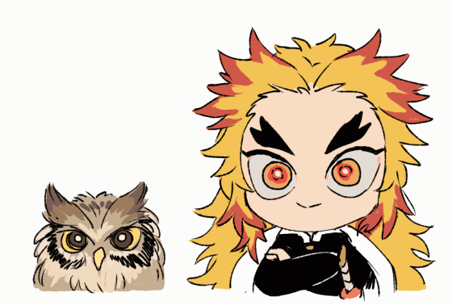
Unit 4- Vocabulary II
I can learn more!!P59

Slide 15
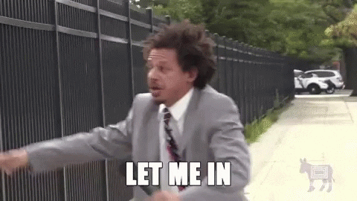
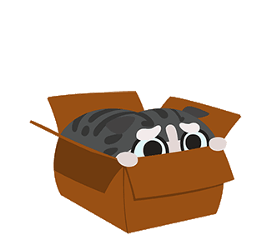
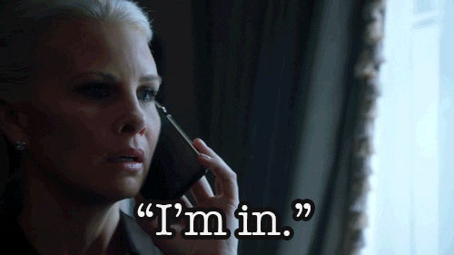
Let me in!
in
I’m in!

Slide 16
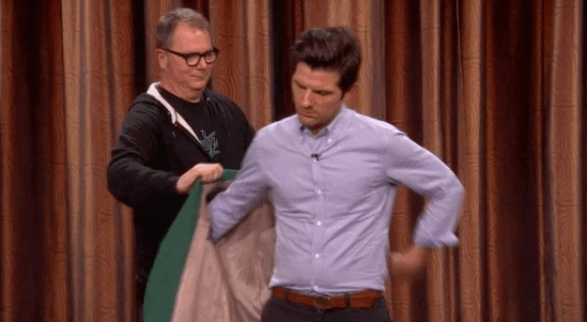
on my way
on
put on

Slide 17
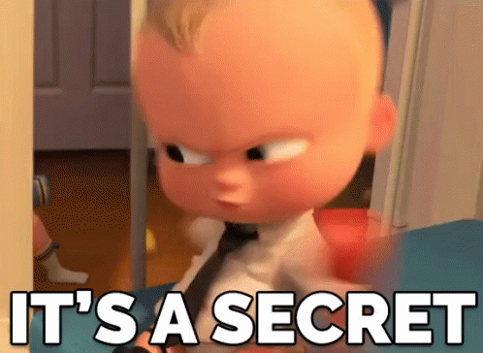
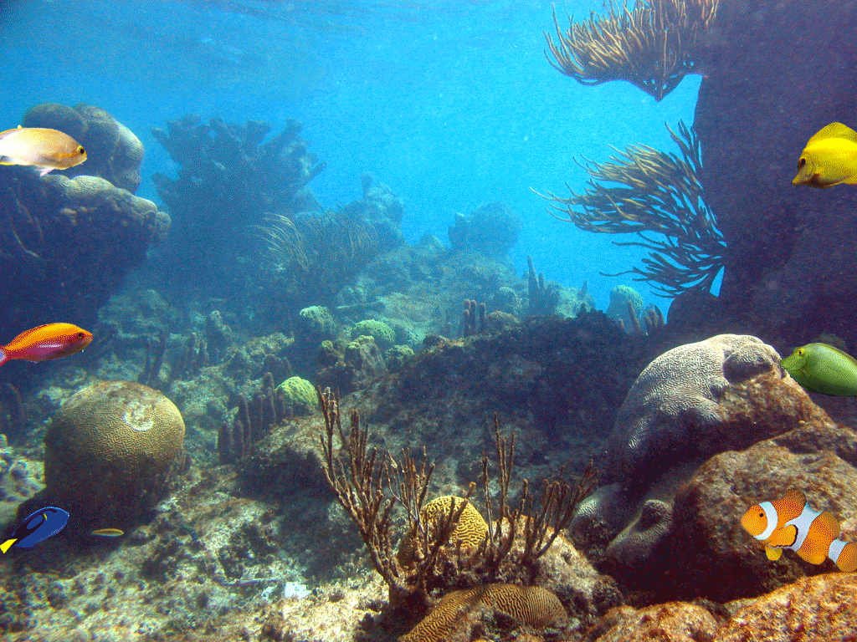
under the table
under
under the sea

Slide 18
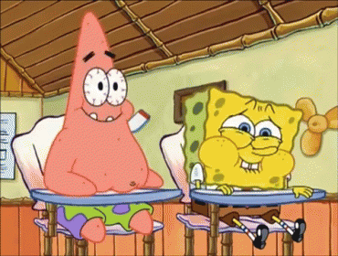
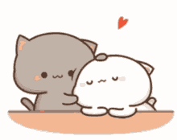
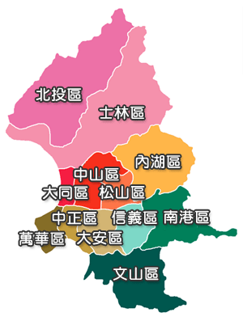
sit next to me
next to
XinYi District is next to…

Slide 19
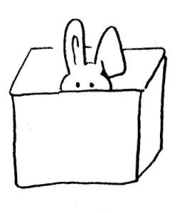
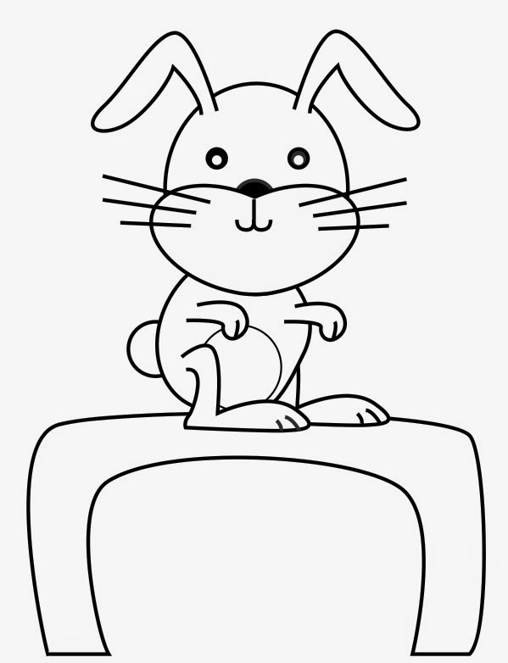
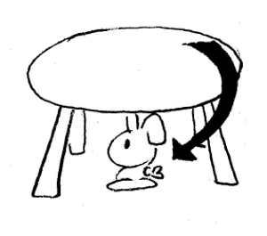
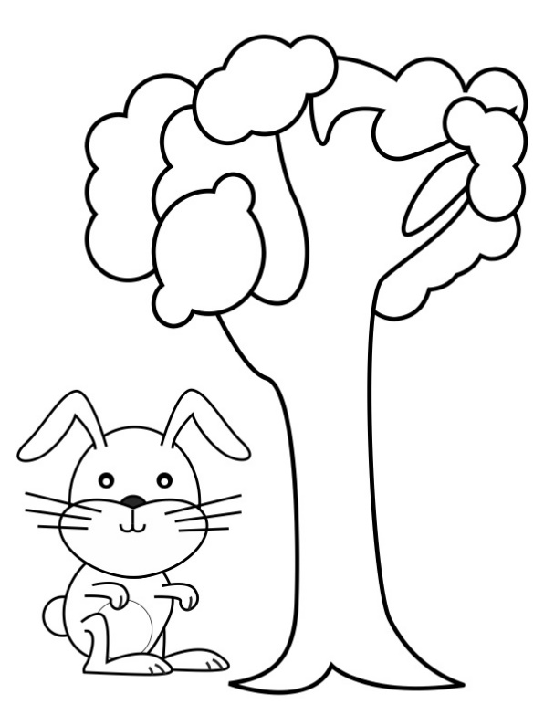
Prepositions
in on under next to
Mandy Says……
20秒去拿一個自己喜歡並可以握在手中的小東西

Slide 20
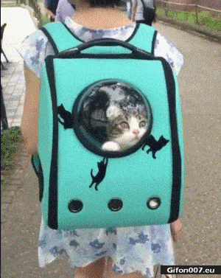
Where is the cat?
It’s ___ the bag.
in
in / on /
under/ next to

Slide 21
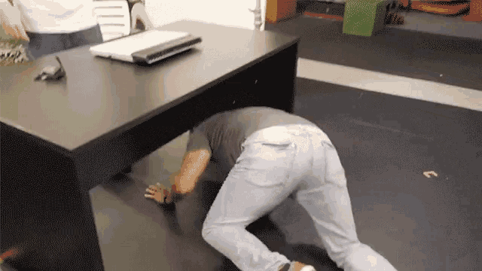
Where is the man?
He’s ____ the
desk.
under
in / on /
under/ next to

Slide 22
Where is the mushroom?
It’s ___ the chair.
on
in / on /
under/ next to

Slide 23
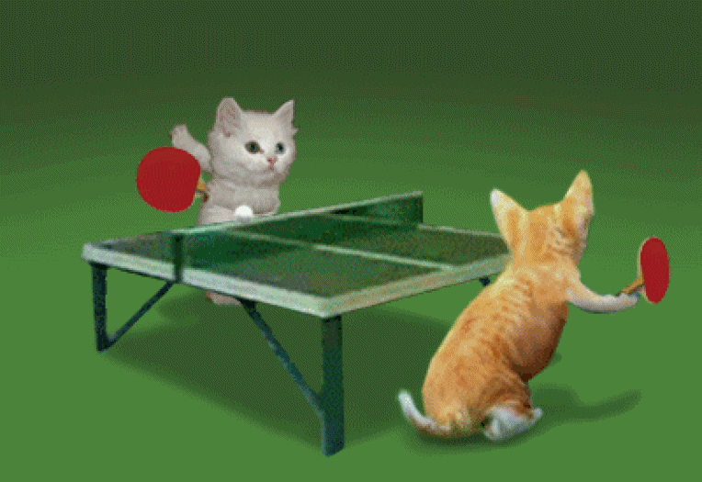
Where are the cats?
They’re ______
the table.
next to
in / on /
under/ next to

Slide 24
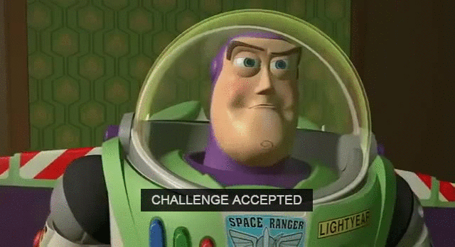
Challenge Time: Look. Write. Show.

Slide 25
Where is Pikachu?
It’s __ the box.
in
in / on /
under/ next to

Slide 26
Where is the man?
He’s __ the ball.
on
in / on /
under/ next to

Slide 27
Where are the eggs?
under
They’re ____ the penguins.
in / on /
under/ next to

Slide 28
Where is Belle?
She’s ______ the bad guy.
next to
in / on /
under/ next to

Slide 29
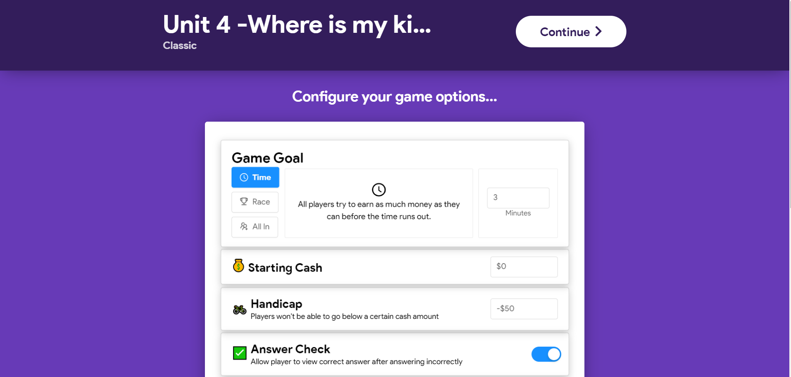
Gimbit大挑戰 https://www.gimkit.com/live

Slide 30
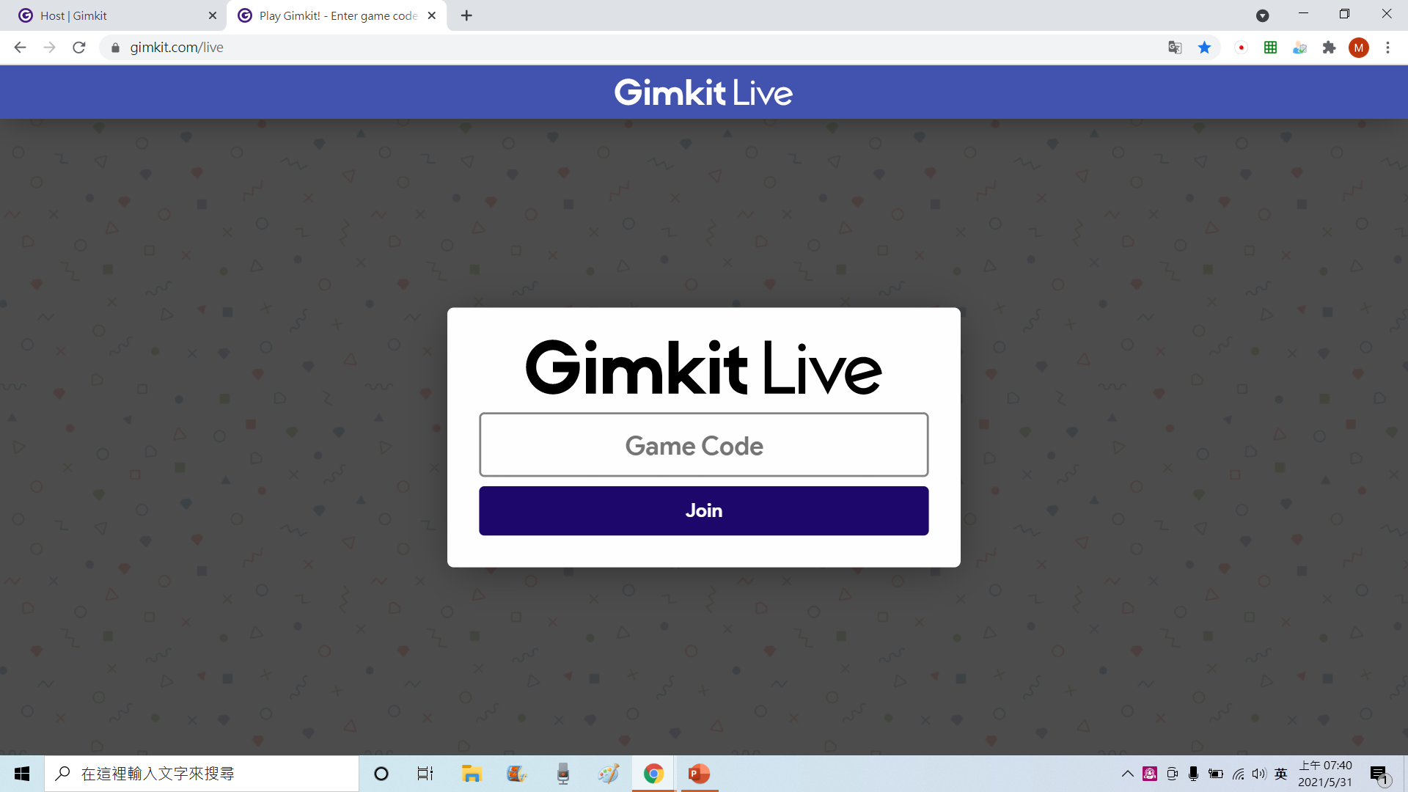
輸入6個數字

Slide 31
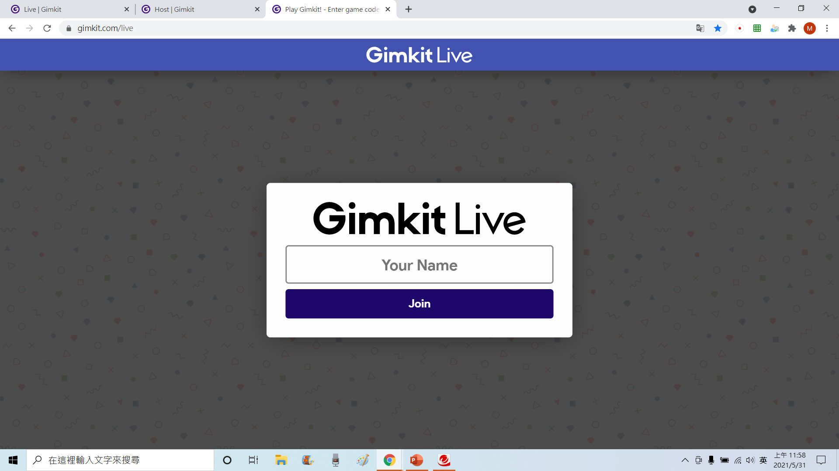
輸入自己的英文名字

Slide 32
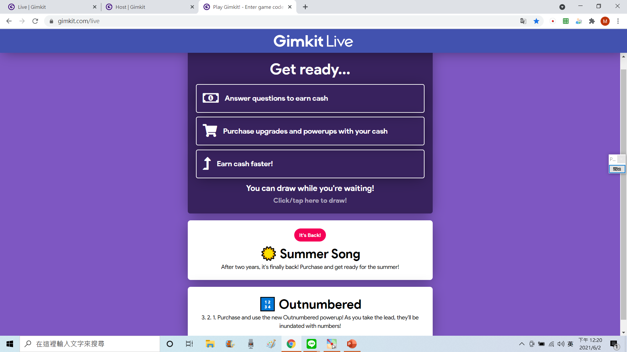
看到這個頁面表示登入成功了!
請停在這個畫面等待老師按開始 ☺

Slide 34
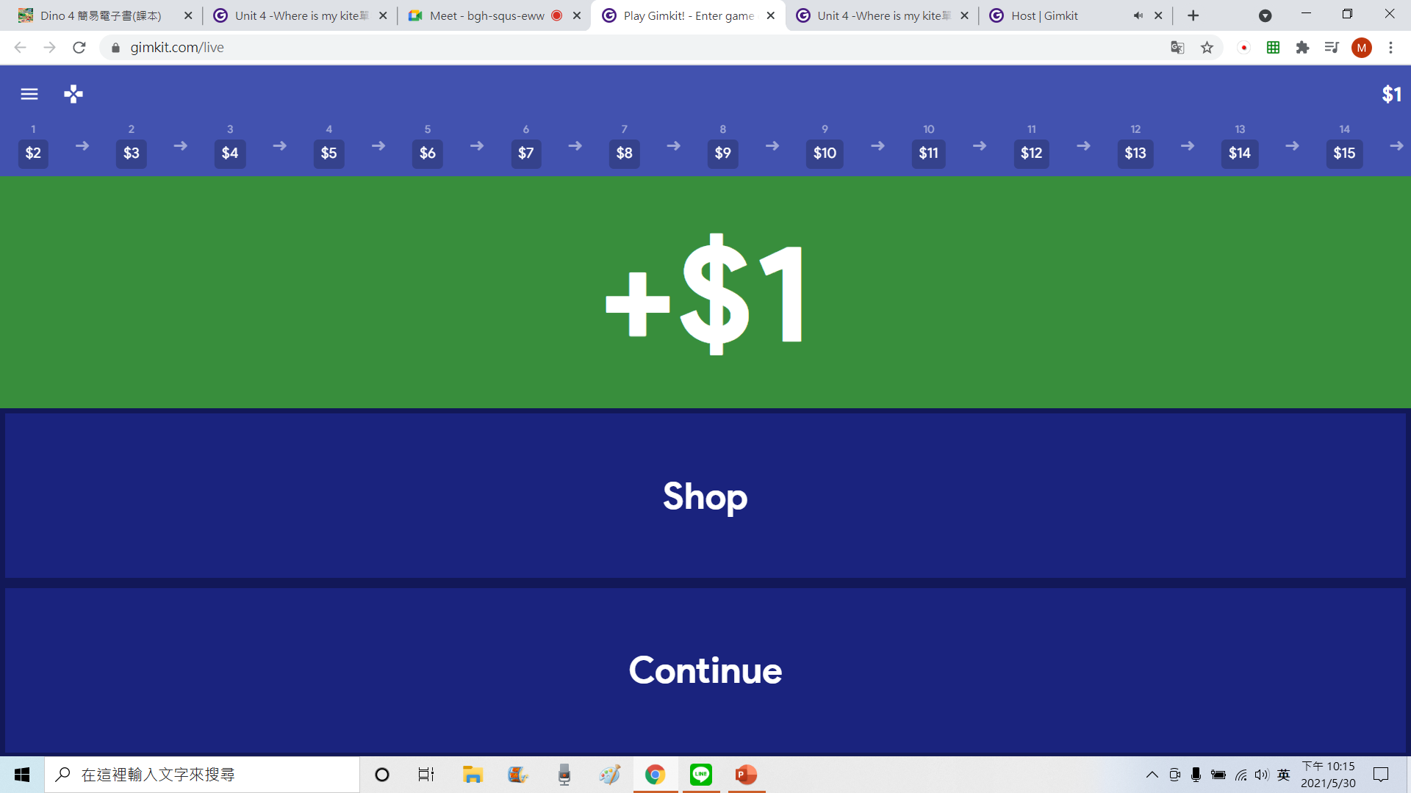

Slide 35
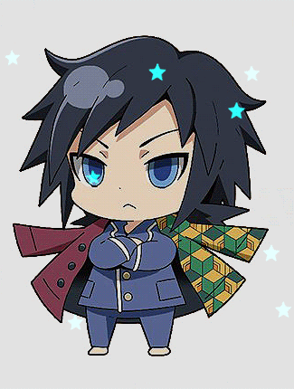
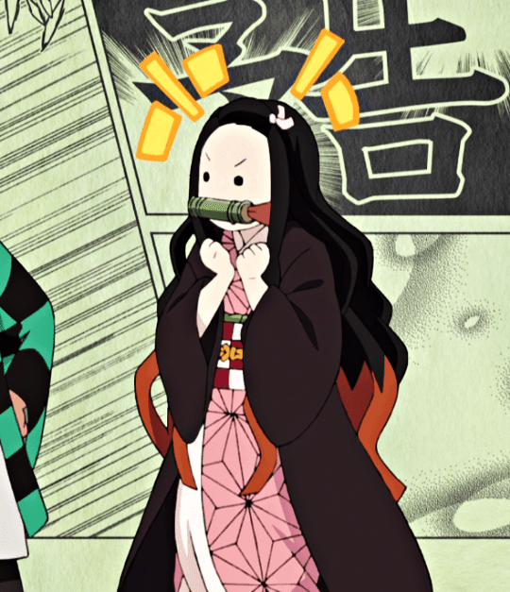
Did you finish your homework last week?
Maybe…yes!
酷課雲
Unit 3線上測驗
Unit4聽力作業
Due date is 6/4, this Friday!!

Slide 36
a box
a ball
chairs
a key
a table
a kite
a desk

Slide 37
Let me in!
in
I’m in!

Slide 38
on my way
on
put on

Slide 39
under the table
under
under the sea

Slide 40
sit next to me
next to
XinYi District is next to…

Slide 41
The pony is ______ the desk.
under
in
on
under
next to

Slide 42
The cat is ______ the rabbit.
next to
in
on
under
next to

Slide 43
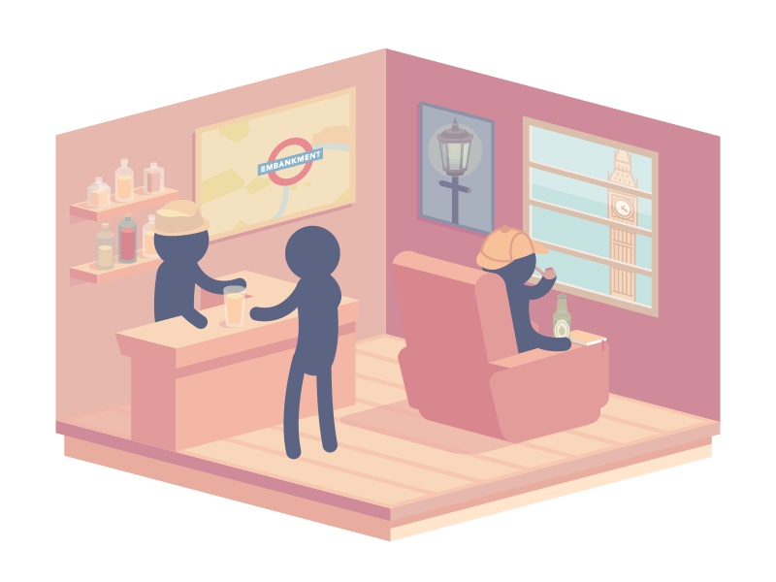
They are ______ the store.
in
in
on
under
next to

Slide 44
The cow is ______ the car.
on
in
on
under
next to

Slide 45
The worms are ______ the stone.
under
in
on
under
next to

Slide 46
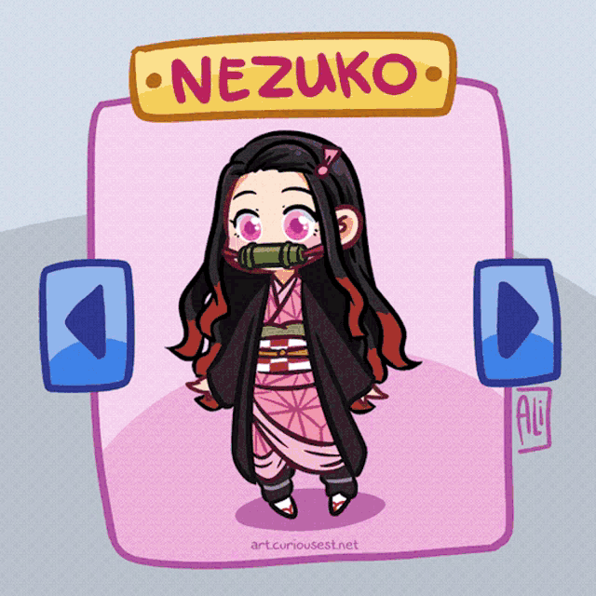
Challenge Time: Look. Write. Show.

Slide 47
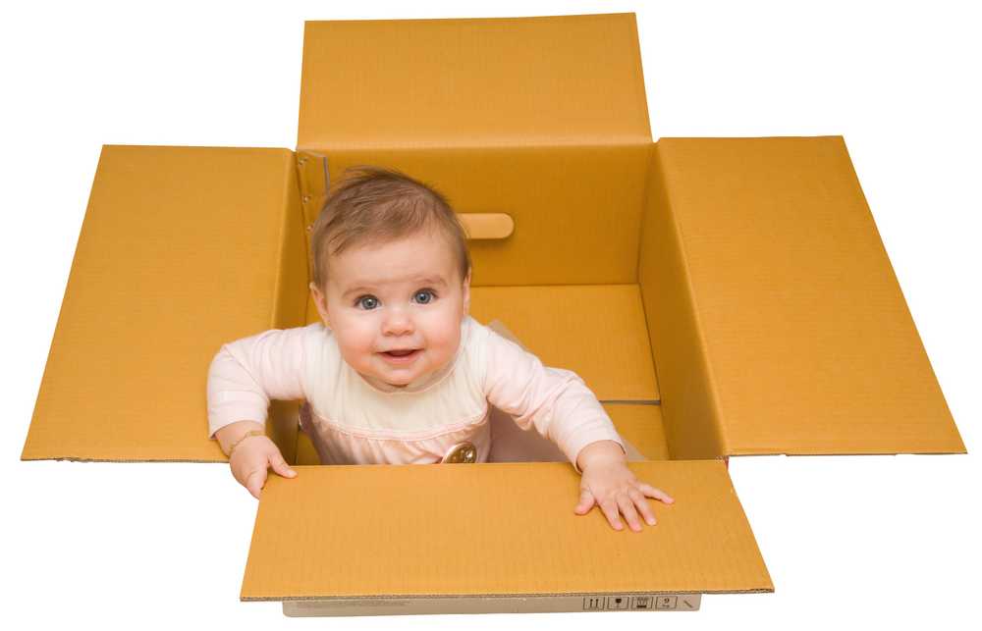
The baby is ______ the box.
in
on
under
next to

Slide 48
The spider is _____ the roof.
in
on
under
next to

Slide 49
The pigs are ______ the tiger.
in
on
under
next to

Slide 50
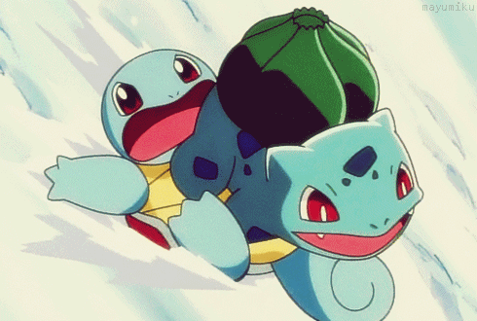
Squirtle is ______ Bulbasaur.
in
on
under
next to

Slide 51
Newton is ______ the apple tree.
in
on
under
next to

